Slide 1
What is Energy?

Slide 2
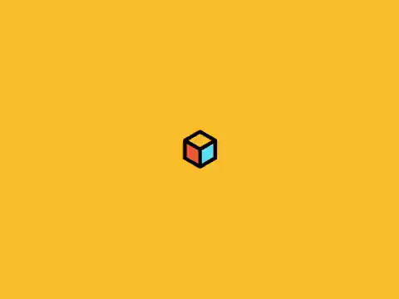
By the end of this Smart Lesson you should be able to:
Define energy.
Recall the two main types of energy.

Slide 3
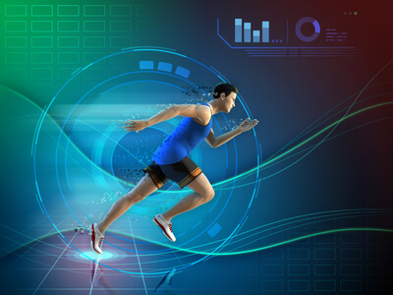

Energy is a word we use to describe how active we feel.
A runner may say they have a lot of energy, while a student may say they have very little energy!
We eat and sleep to regain energy, and we use it up playing sport and doing housework.

Slide 4
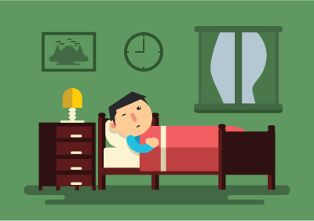
When you wake up in the morning, you probably are quite low on energy.
It's hard to move, and you don't want to get up. Then, after some moving around and some breakfast, you're suddenly full of energy!
But what does energy actually mean?

Slide 5
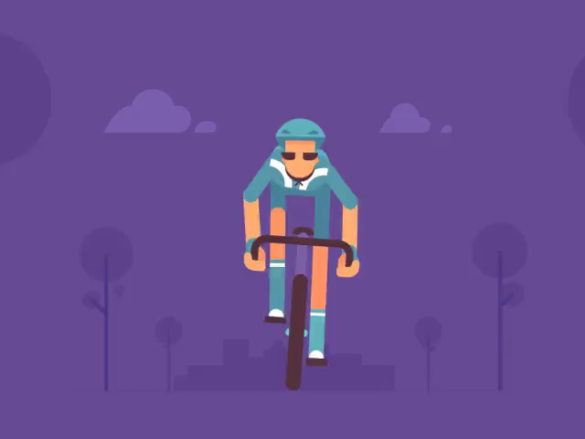
Energy is the ability of an object to do work.
If an object is doing work, it is making something happen. Walking, running, cycling and swimming are all types of work because you use energy to do them.

Slide 6
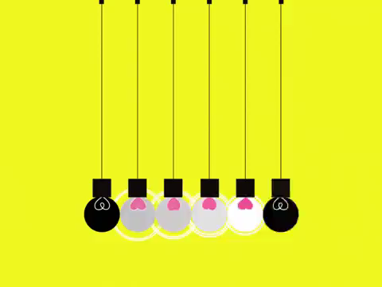
Lightbulbs use energy to make light and cars use energy to drive.
Energy is made available to use by the food you eat, or by the power plugs on your wall.
Energy is everywhere, and constantly being used by everything. How can there be so much energy in the world?

Slide 7

Everything in the universe has some amount of energy, even if it is not moving!
For example, a rock sitting on the ground seems like something with absolutely no energy. But it is actually moving very quickly indeed as the Earth moves about the Sun!

Slide 8
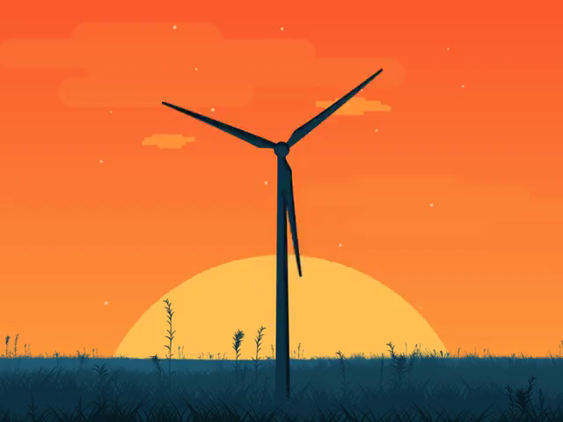
Energy is defined by what it does.
It has many different forms, all named after what the energy is doing in that form.
Energy is able to transform between these forms, and can be transferred between objects. Work is done when energy is transformed or transferred.

Slide 9
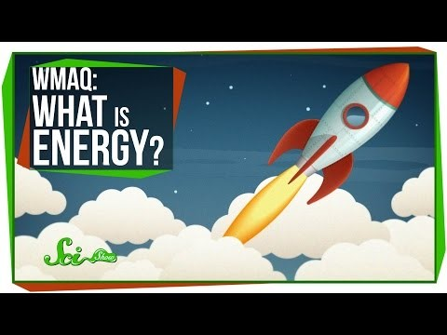

Slide 10
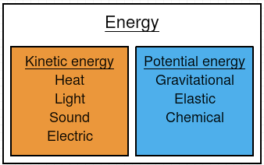
Energy can be split into two different types: kinetic energy and potential energy.
Kinetic energy is energy associated with movement. Potential energy is energy that is stored in objects.

